Slide 1
Creating a Bot to Play Ticket to Ride
Cameron Ake
Computer Systems Research Lab
Dr. Yilmaz Period 4
5/21/2024

Slide 2
Problem
Making a bot to play Ticket to Ride
Strategy board game
Playing a bot is typically most feasible for players
Playing friends online isn’t feasible
Playing in-person takes an hour
Current bots usually lose to players: hard to experiment with strategies or have fun

Slide 3
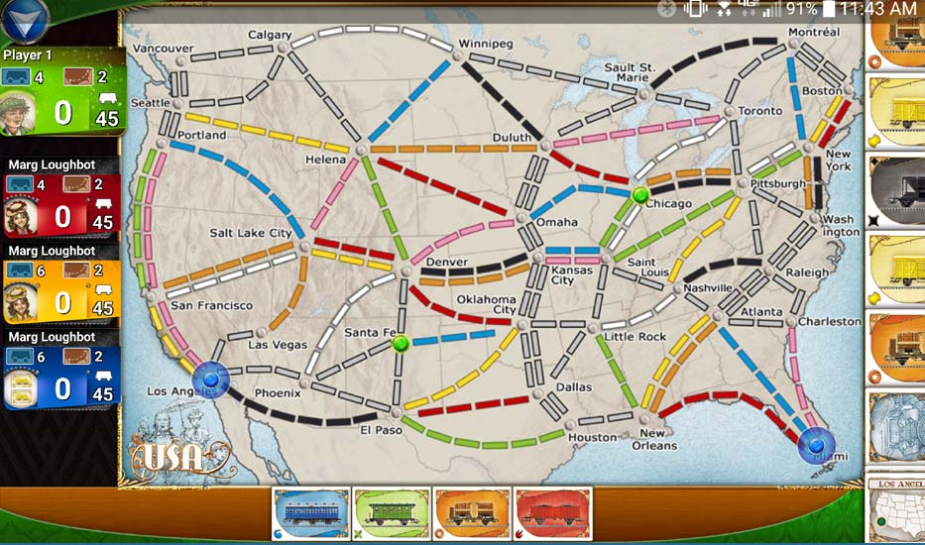
BACKGROUND
Ticket to Ride App
Game mechanics
Drawing cards
Tickets
Playing trains
Earning points
Game end
Notes:
Image from https://oneboardfamily.com/app-review-ticket-ride/

Slide 4
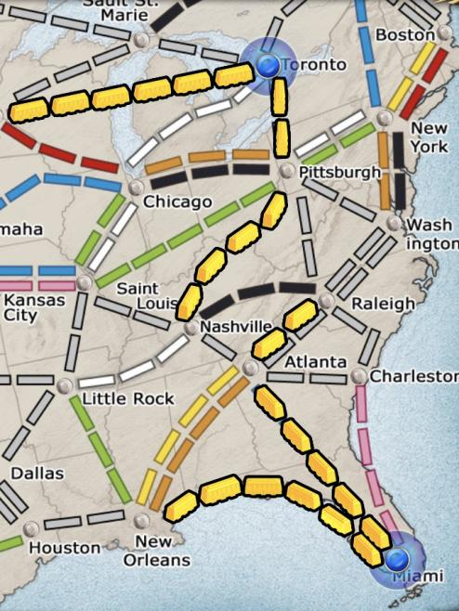
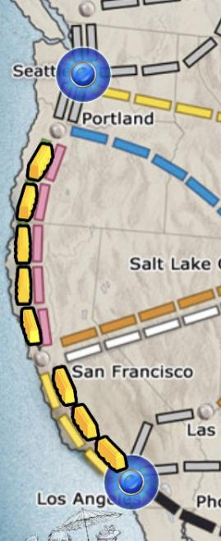
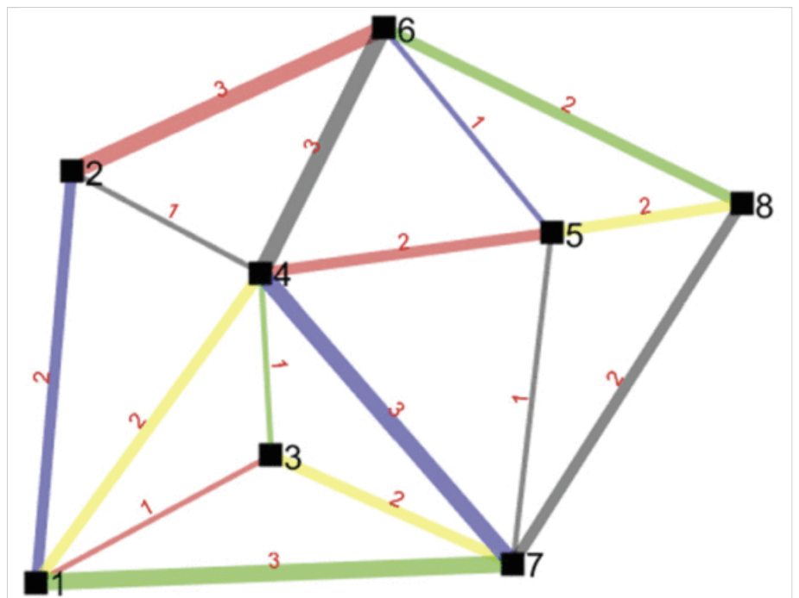
OTHER SOLUTIONS
Current Ticket to Ride bots
Transparently bad decisions (e.g. for routes)
Previous implementations:
Reinforcement learning?
People online
Nothing in terms of learning strategy; misimplementation

Slide 5
Why IS Mine BETTER?
Novelty
Discussed in part earlier
Use varying parameters to simulate different strategies
Many iterations of bots playing against each other
Using genetic algorithm: bots actually “learn” good strategies on their own
More tailorable to choose bots at any particular desired skill level
New implementation
Nobody has made a bot with this algorithm: better (hopefully) bot!
More often that the bot wins compared to the lackluster current bots, but not so often that it will discourage humans

Slide 6
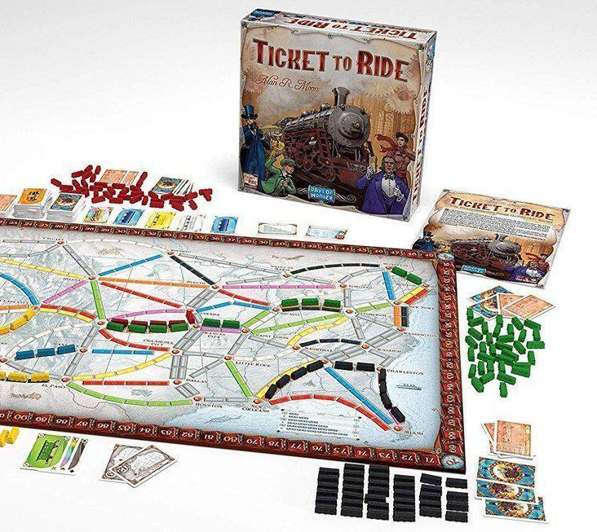
ImPACT
Ticket to Ride players could play challenging bots
Develop abilities; enjoy game
Possibilities of AI for complex games
Genetic algorithm w/heuristics rare

Slide 7
METHOD: Heuristic Function
Bots use a heuristic function to estimate which moves will be best
Each bot has trainable values A, B, C, D... that determine value of the function
Heuristic Function for Good Moves:
= A * (amount that playing trains here would help get routes)
+ B * (change in longest route) + ... +
+ F * (amount that taking this card would help get routes) + …
...and so forth
The bot takes the move with the highest heuristic value!

Slide 8
METHOD: Genetic Algorithm
Genetic algorithm
Pit bots against each other
Have algorithm select best parameters for decision-making
Generate new bots based on the most successful bots
Bots play game:
Assign each bot a probability of surviving/reproducing, based on its score in the game
Bots survive:
Select 10 of 20 bots to survive
repeat!
Create children:
Child gets half of each parent’s parameters and shifts them a bit
Bots breed:
Select pairs of bots to breed

Slide 9
RESULTS
Algorithm had a “favorite bot”
Performed better than other bots, but scored only somewhat above-average (114 points in session 1 of training, 104 in session 4)
Bugs—often four or five per day
Time issues
Complexity of card-drawing
Gray trains
Each training session taking 30 minutes to an hour
Displays on the next few
slides...
The face-up deck should only be 5 cards. Here, it is 11. I love bugs!

Slide 10
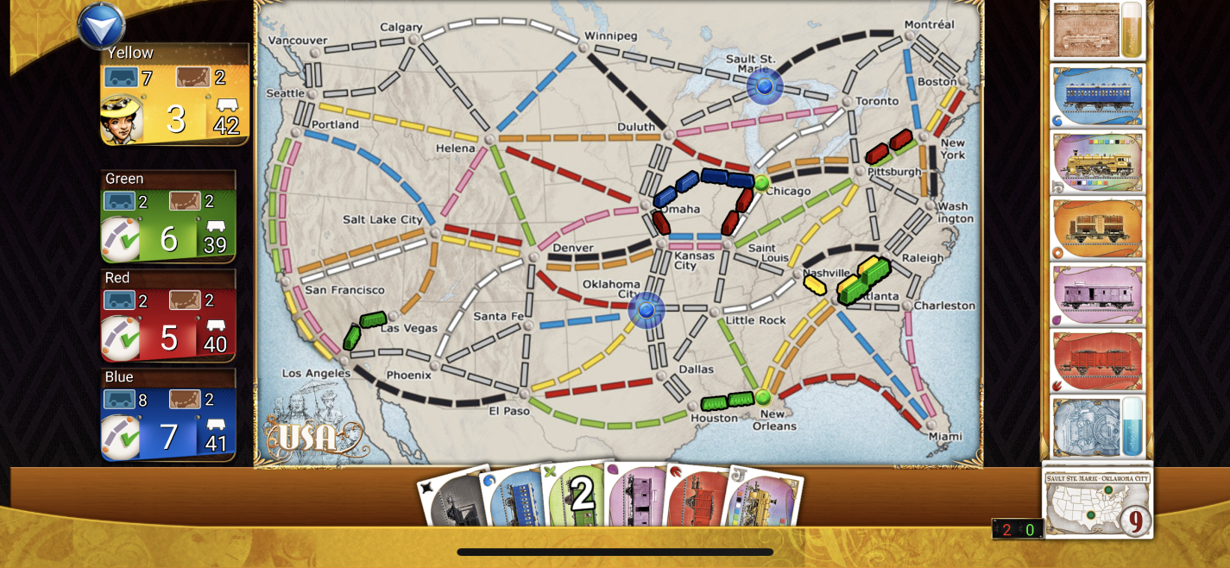
RandomBots
Note how they’ve all taken small routes: RNG told them to take a route and they took routes despite not having accumulated many cards of the same color. Shocking no one, the RandomBots are not particularly smart.

Slide 11
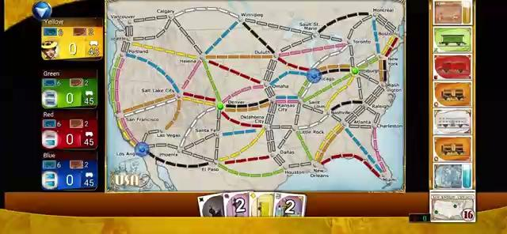
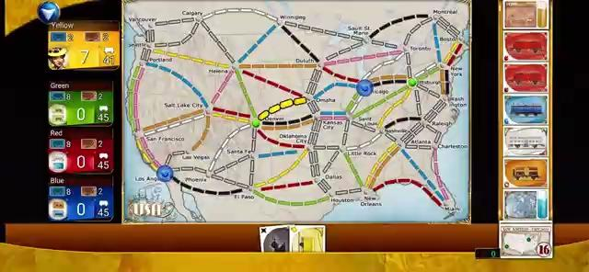
Final HeuristicBot Rationale Demo
Left: The bot takes a route directly in both of the tickets it’s trying to take.
Right: The bot takes a blue card, important for taking Omaha-Chicago, a route in both of the tickets it’s trying to take.

Slide 12
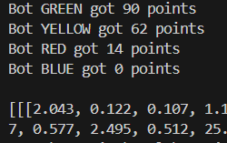
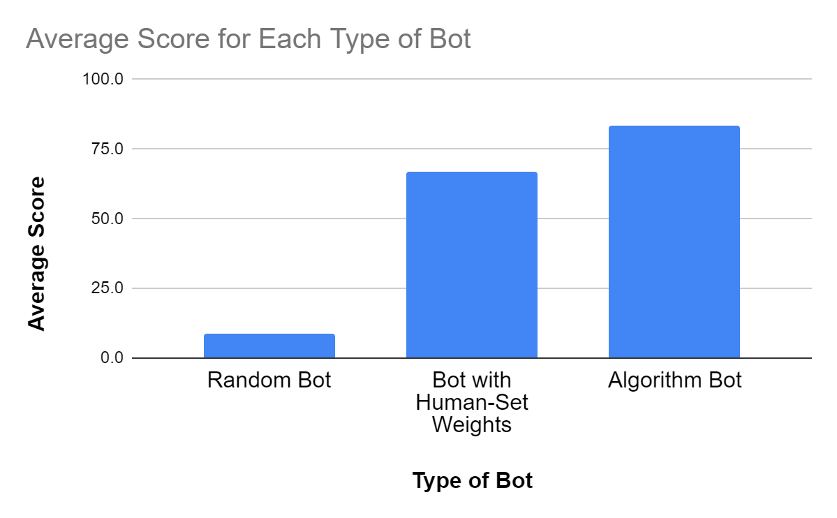
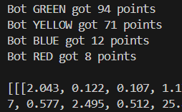
Final HeuristicBot Game Demo
Green and Yellow bots are copies of the final HeuristicBot, playing against RandomBots Red and Blue for contrast.
Comparison of average bot scores (around 10 repetitions)
Note: Video demo of code implausible, as code takes 30+ minutes to run

Slide 13
Limitations
Difficulty of implementing reinforcement learning: super complicated game
Copyright problematic for simply creating a website:
Possibility of creating spinoff
Alternative possibility of selling AI algorithms to Days of Wonder to implement
Bots, although much stronger than RandomBots, don’t excel as highly
Actual players can get >100 points against RandomBots

Slide 14
CONCLUSION AND FUTURE WORK
Genetic algorithm produces suitable bots, although not excellent
Limited, but better than RandomBot / other HeuristicBots
Potential future work:
Final HeuristicBot vs. human-designed HeuristicBot
Average human player vs. HeuristicBot
More heuristics
Exploring reinforcement learning based more directly on the board

Slide 15
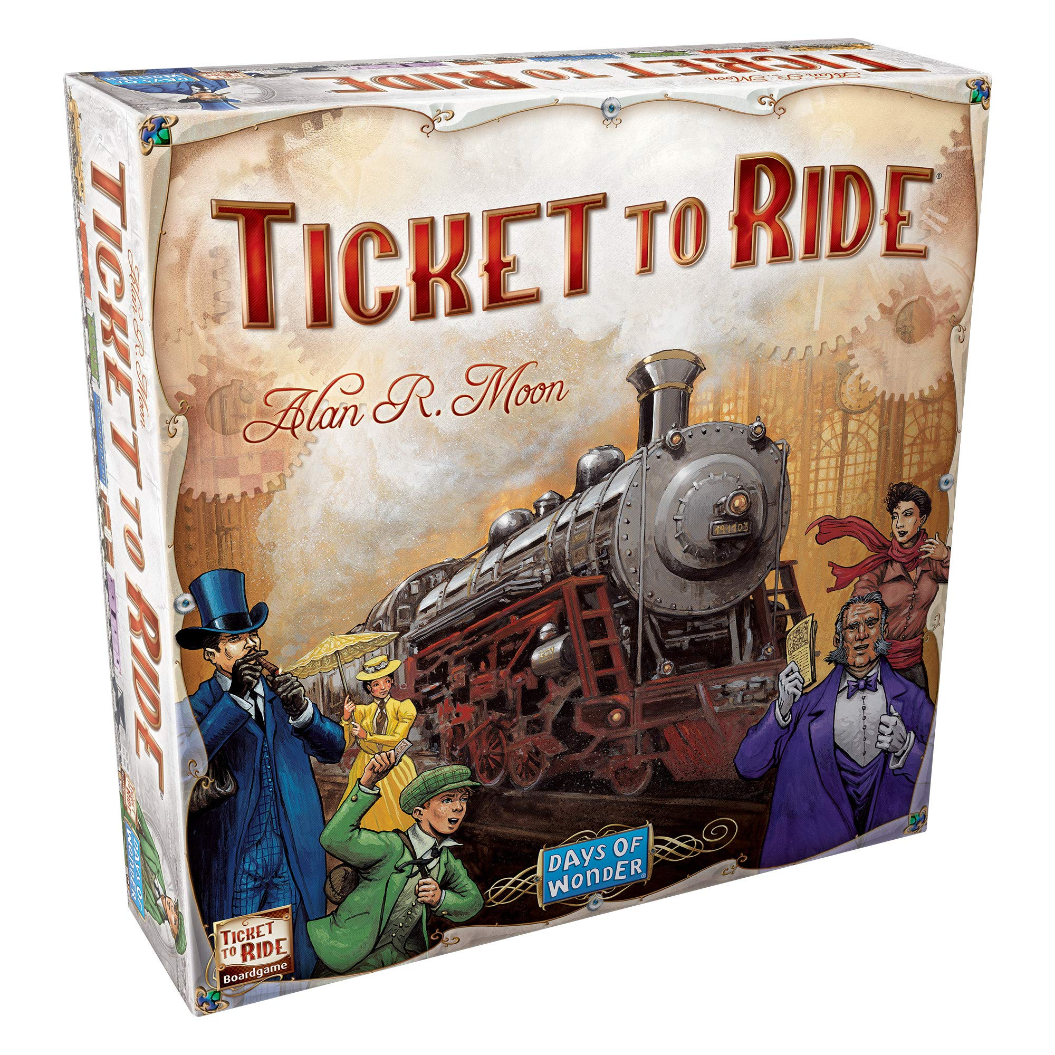
Q&A
Thanks!
Questions?

Slide 16
REFERENCES
Ticket to Ride app from Days of Wonder on App Store
Stack Overflow for Python tips (most notably, sorting out data structures and classes in different files)
Destination ticket data from Fandom
Reinforcement Learning Is Bad For TTR paper (Daniel Dinjian & Cuong Nguyen, from Tufts University)
Reddit Person Who Made More Basic Bot
Github With Bad Data Structures and Java
railbyrail.com
Professors who Used Reinforcement Learning
Used this image link to visualize some stuff without the app when necessary

Slide 17
THANK YOU!

